Slide 1
Classification
Supervised Machine Learning
Classification
Logistic Regression
Decision Tree
Random Forest
Support Vector Machine

Slide 2
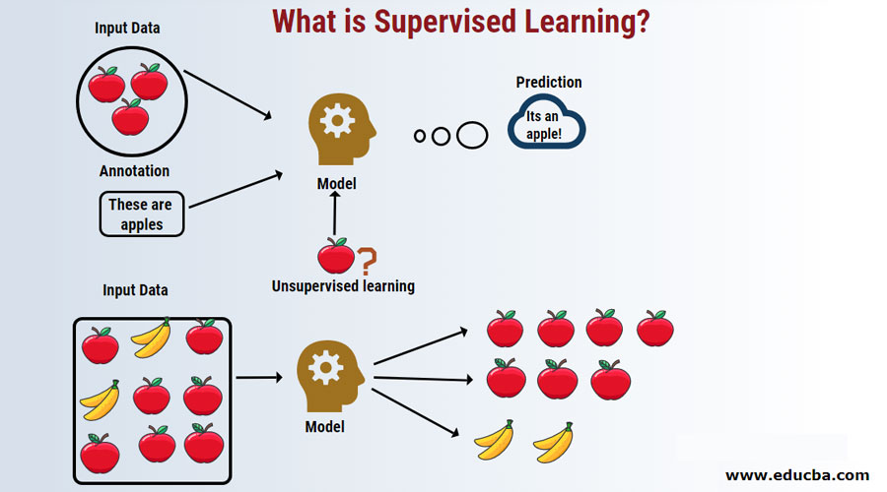
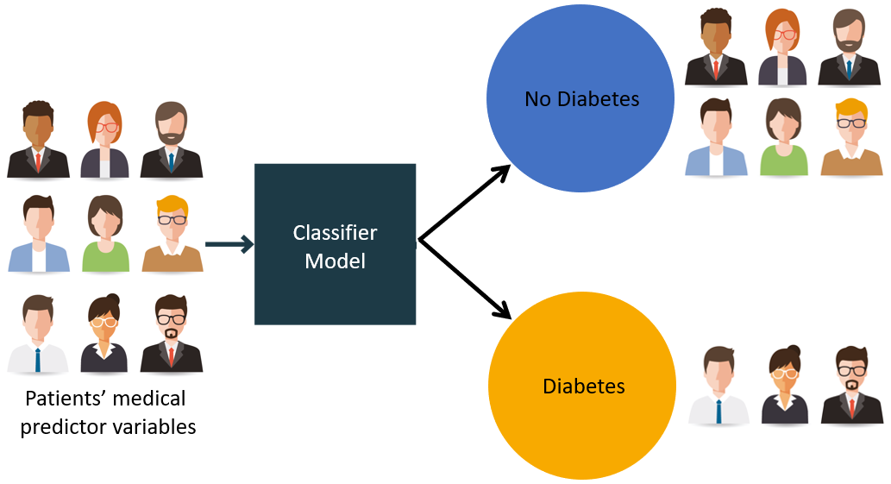
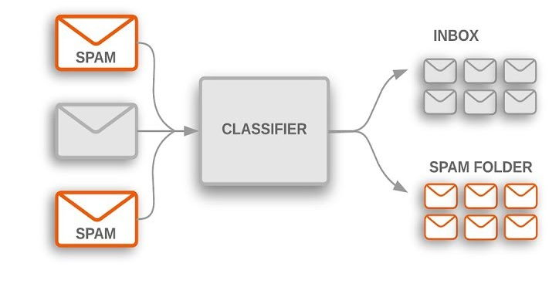
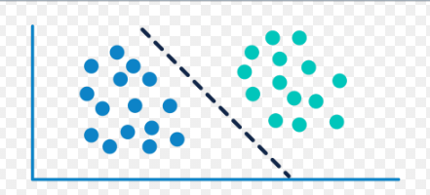
Classification Examples

Slide 3
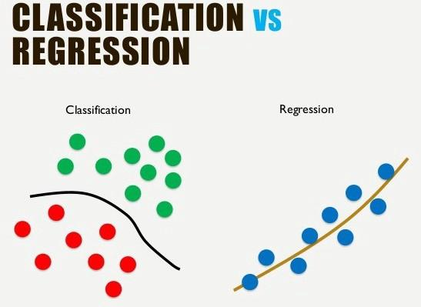
Regression Vs Classification
Classification predicts the category the data belongs to
Regression predicts a numerical values based on previously observed data

Slide 4
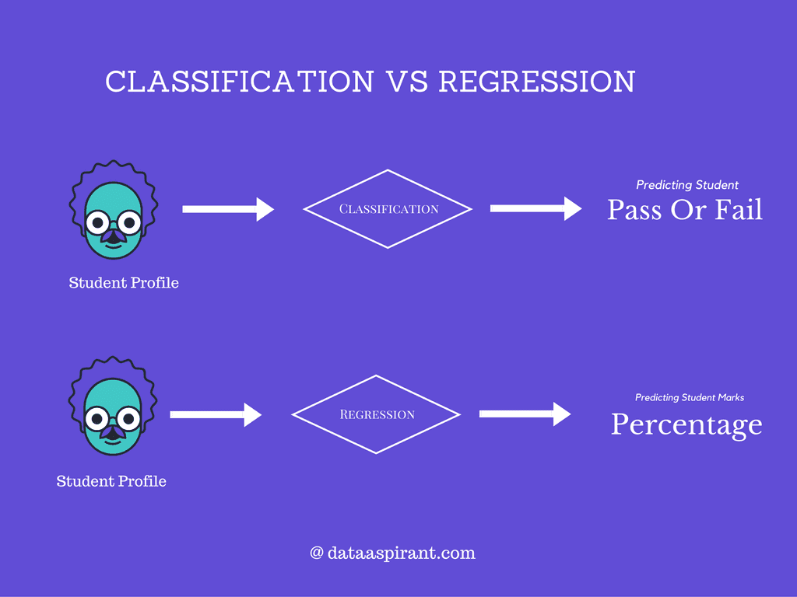
Regression Vs Classification

Slide 5
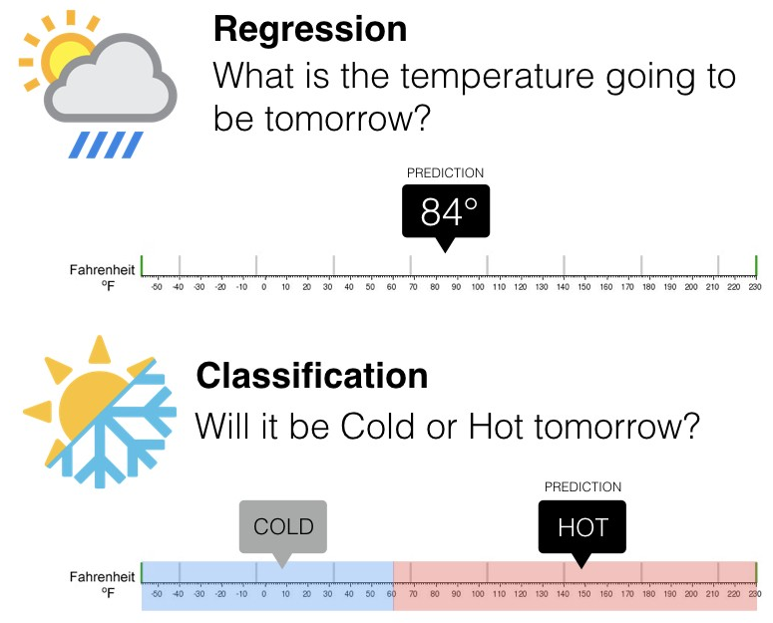
Regression Vs Classification

Slide 6
Classification
Classification is a supervised machine learning method where the model tries to predict the correct label of a given input data.

Slide 7
Classification Process
Classification is a two step process:
Learning step (or training phase)
Where a classification algorithm builds the classifier by analyzing or “learning from” a training set made up of database tuples and their associated class labels.
A tuple, X, is represented by an n-dimensional attribute vector, X = (x1, x2,..., xn), depicting n measurements made on the tuple from n database attributes, respectively, A1, A2,..., An.
Each tuple, X, is assumed to belong to a predefined class as determined by another database attribute called the class label attribute.

Slide 8
The class label attribute is discrete-valued and unordered, it is categorical (or nominal) in that each value serves as a category or class.
The individual tuples making up the training set are referred to as training tuples
Because the class label of each training tuple is provided, this step is also known as supervised learning.
The classifier or model generated in the first step of classification algorithm can be a classification rules, decision trees, or mathematical formulae.

Slide 9
Classification Process
II classification step (or Testing Phase)
In second step the model is used for classification, first it is used on a test data to check its accuracy.
Estimate accuracy of the model ,the known label of test sample is compared with the classified result from the model
Accuracy rate is the percentage of test set samples that are correctly classified by the model
Test set is independent of training set, otherwise over-fitting will occur
If the accuracy is acceptable, use the model to classify data tuples whose class labels are not known

Slide 10
Classification : Example
Class label
Attributes
Patient Id | Sore throat | Fever | Swollen Glands | Congestion | Headache | Diagnosis
1 | Yes | Yes | Yes | Yes | Yes | Strep throat
2 | No | No | No | Yes | Yes | Allergy
3 | Yes | Yes | No | Yes | No | Cold
4 | Yes | No | No | No | No | Strep throat
5 | No | Yes | No | Yes | No | Cold
6 | No | No | No | Yes | No | Allergy
7 | No | No | Yes | No | No | Strep throat
8 | Yes | No | No | Yes | Yes | Allergy
9 | No | Yes | No | Yes | Yes | Cold
10 | Yes | Yes | No | Yes | Yes | Cold

Slide 11
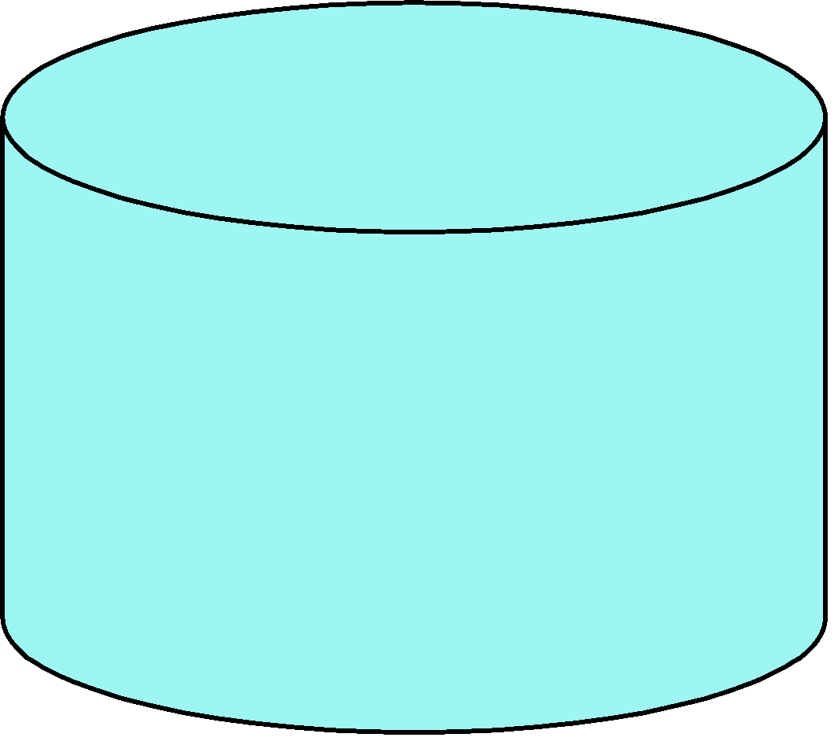
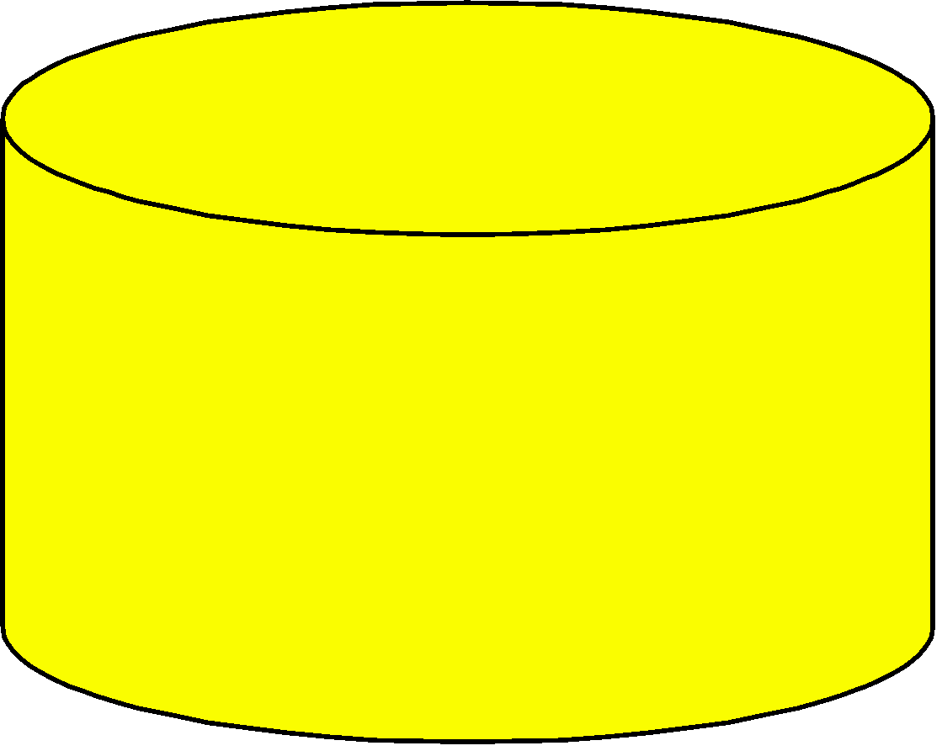
Step I: Learning step (or training phase)
Classification
Algorithms
Training
Data
Patient Id | Sore throat | Fever | Swollen Glands | Congestion | Headache | Diagnosis
1 | Yes | Yes | Yes | Yes | Yes | Strep throat
2 | No | No | No | Yes | Yes | Allergy
3 | Yes | Yes | No | Yes | No | Cold
4 | Yes | No | No | No | No | Strep throat
5 | No | Yes | No | Yes | No | Cold
6 | No | No | No | Yes | No | Allergy
7 | No | No | Yes | No | No | Strep throat
8 | Yes | No | No | Yes | Yes | Allergy
9 | No | Yes | No | Yes | Yes | Cold
10 | Yes | Yes | No | Yes | Yes | Cold
Classifier
(Model)
Swollen
Glands
No
Yes
Fever
Diagnosis=Strep Throat
No
Yes
Diagnosis=Allergy
Diagnosis =Cold

Slide 12
Step II : Classification step (or testing phase)
Swollen
Glands
No
Yes
Test
Data
Fever
Diagnosis=Strep Throat
No
Yes
Diagnosis=Allergy
Diagnosis =Cold
Patient Id | Sore throat | Fever | Swollen Glands | Congestion | Headache | Diagnosis
1 | Yes | Yes | Yes | Yes | Yes | Strep throat
2 | No | No | No | Yes | Yes | Allergy
3 | Yes | Yes | No | Yes | No | Cold
4 | Yes | No | No | No | No | Strep throat
5 | No | Yes | No | Yes | No | Cold
6 | No | No | No | Yes | No | Allergy
7 | No | No | Yes | No | No | Strep throat
8 | Yes | No | No | Yes | Yes | Allergy
9 | No | Yes | No | Yes | Yes | Cold
10 | Yes | Yes | No | Yes | Yes | Cold
Accurate ?
Use model
Update model

Slide 13
Classification Terminologies
Classifier: An algorithm that maps the input data to a specific category.
Classification model: A classification model tries to draw some conclusion from the input values given for training. It will predict the class labels/categories for the new data.
Feature: A feature is an individual measurable property of a phenomenon being observed.
Binary Classification: Classification task with two possible outcomes. E.g.: Gender classification (Male / Female)

Slide 14
Classification Terminologies
Multi-class classification: Classification with more than two classes. In multi class classification each sample is assigned to one and only one target label. E.g.: An animal can be cat or dog but not both at the same time
Multi-label classification: Classification task where each sample is mapped to a set of target labels (more than one class). E.g.: A news article can be about sports, a person, and location at the same time.

Slide 15
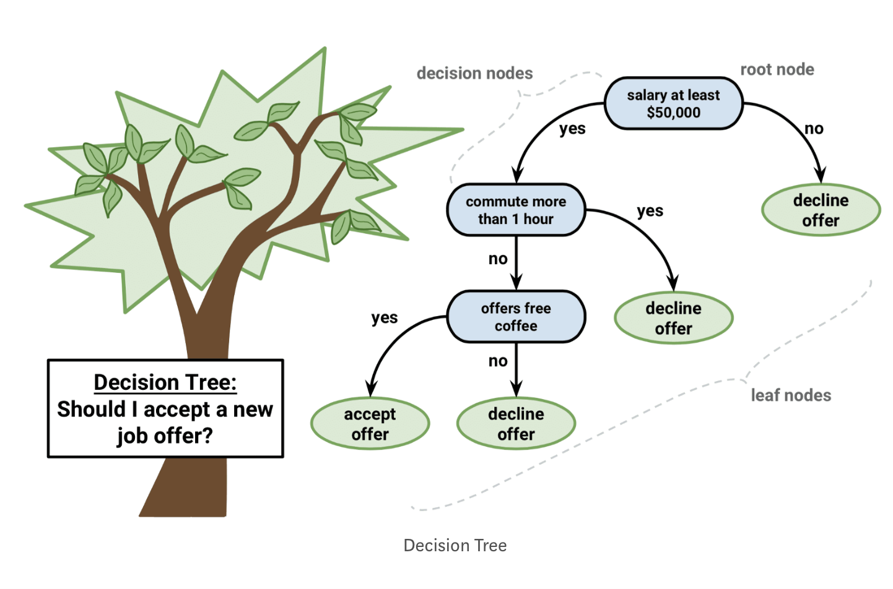
Decision Tree Classification

Slide 16
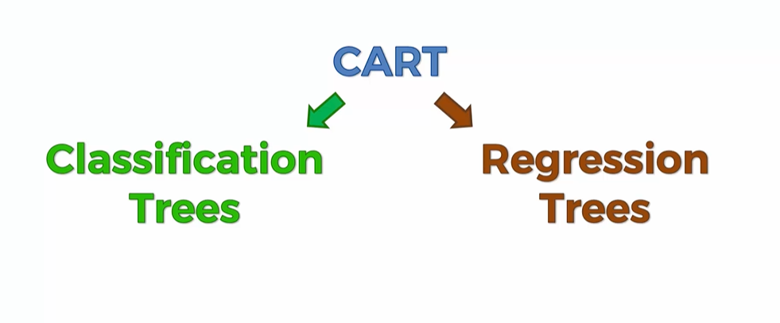
Decision Tree Classification

Slide 17
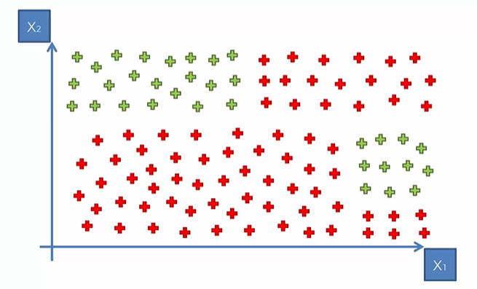
Decision Tree : How it works?
Split 2
60
Split 3
Split 1
0
Split 4
50
70

Slide 18
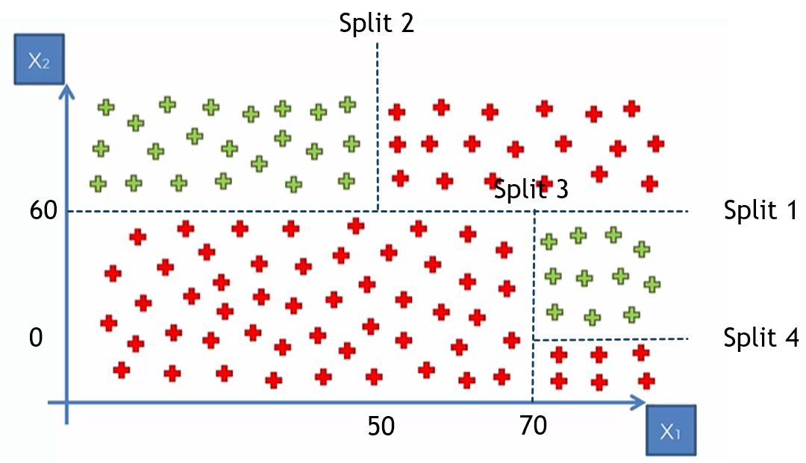
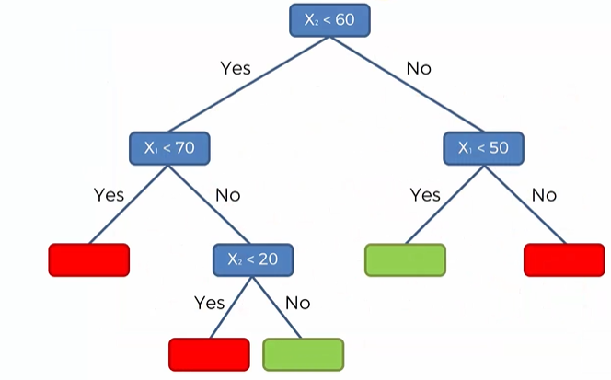
Decision Tree : How it works?

Slide 19
Decision tree classifier
Decision Tree is a Supervised learning technique that can be used for both classification and Regression problems, but mostly it is preferred for solving Classification problems.
It is a tree-structured classifier, where internal nodes represent the features of a dataset, branches represent the decision rules and each leaf node represents the outcome.
In a Decision tree, there are two nodes, which are the Decision Node and Leaf Node.
Decision nodes are used to make any decision and have multiple branches, whereas Leaf nodes are the output of those decisions and do not contain any further branches.
The decisions or the test are performed on the basis of features of the given dataset.

Slide 20
Decision tree classifier
Decision Tree is a Supervised learning technique that can be used for both classification and Regression problems, but mostly it is preferred for solving Classification problems.
It is a tree-structured classifier, where internal nodes represent the features of a dataset, branches represent the decision rules and each leaf node represents the outcome.
In a Decision tree, there are two nodes, which are the Decision Node and Leaf Node.
Decision nodes are used to make any decision and have multiple branches, whereas Leaf nodes are the output of those decisions and do not contain any further branches.
The decisions or the test are performed on the basis of features of the given dataset.

Slide 21
Advantages of decision tree classifier
Extremely fast at classifying unknown records.
Easy to interpret for small-sized trees
Accuracy comparable to other classification techniques for many simple data sets.
Excludes unimportant features.

Slide 22
Disadvantages of decision tree classifier
Easy to overfit.
Decision tree models are often biased toward splits on features having a large number of levels.
Small changes in the training data can result in large changes to decision logic.

Slide 23
Compare classification and regression using suitable example
Explain regression techniques using suitable example
Explain Support vector machine classification using suitable example
Explain decision tree classification using suitable example
Explain Random Forest classification using suitable example
Explain Logistic Regression using suitable example
Explain ensemble learning methods using suitable example

